Slide 1


Buildable DIGITAL HEALTH BLUEPRINT
Developing “construction” documents and an
investment and implementation roadmap for the national HIE
Context, background and use cases
[Date].

Slide 2

WORKSHOP PLAN…
Leverage each successive workshop to progress the development of the blueprint:
Use cases (choosing our initial care pathways)
Digital health specifications (Integration Profiles)
“Lego blocks” (conformant eHealth solutions)
Implementation science (making it “go”)
Each session builds on the one before it…

Slide 3

Workshop-1 Use Cases

Slide 4
WORKSHOP-1 AGENDA
Country context
Digital readiness
Burden of disease
Strategic goals
Health system strategy
Digital health strategy
Key question: “what should our HIE do?”
Next steps

Slide 5

How ready are we to implement digital health infrastructure?

Slide 6
WHAT IS THE DIGITAL READINESS?
<lookup the country entry on the Global Digital Health Monitor; prepare a set of slides summarizing the assessment findings: https://digitalhealthmonitor.org/>
<leverage the GSMA site to obtain mobile network coverage maps from the top network operators: https://www.gsma.com/coverage/>
<show coverage maps for main network operators, one map per slide>
NOTE: example from Botswana

Slide 7
Based on GDHM, how ready are we to implement national-scale digital health infrastructure?

Slide 8
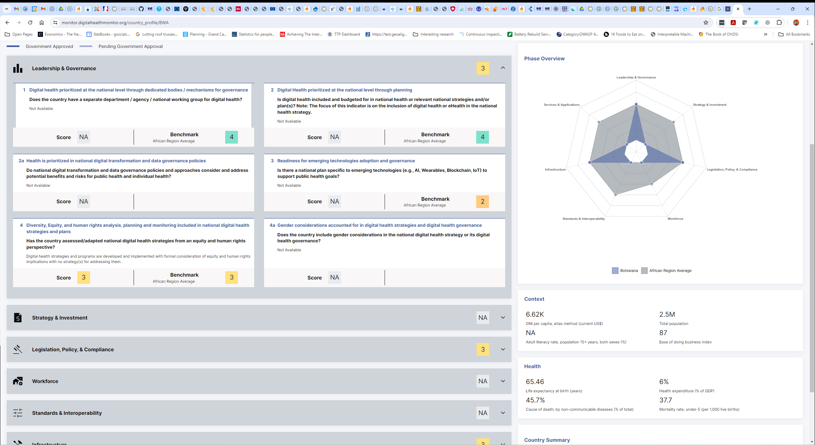
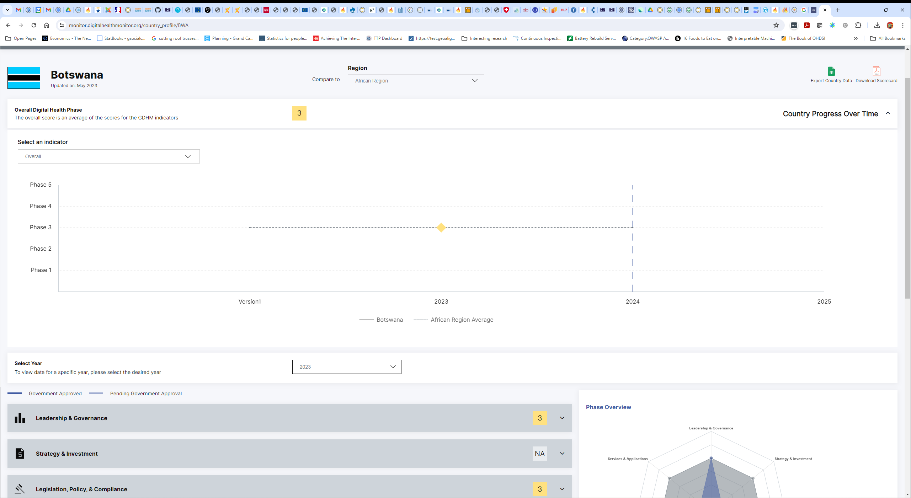
SUMMARY
https://monitor.digitalhealthmonitor.org/country_profile/BWA 2023 data

Slide 9
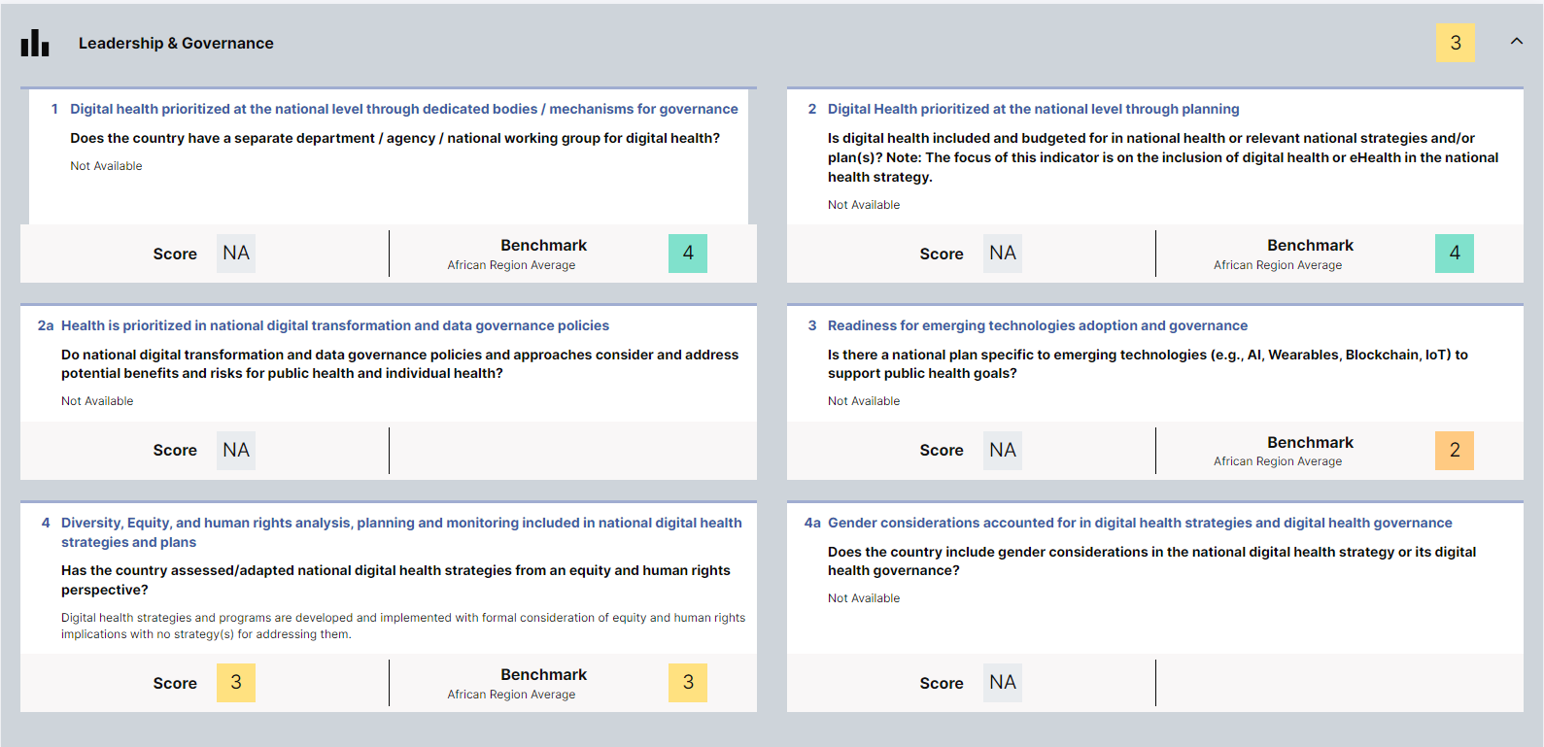
LEADERSHIP & GOVERNANCE
Digital health strategies and programs are developed and implemented with formal consideration of equity and human rights implications with no strategy(s) for addressing them.
https://monitor.digitalhealthmonitor.org/country_profile/BWA 2023 data

Slide 10
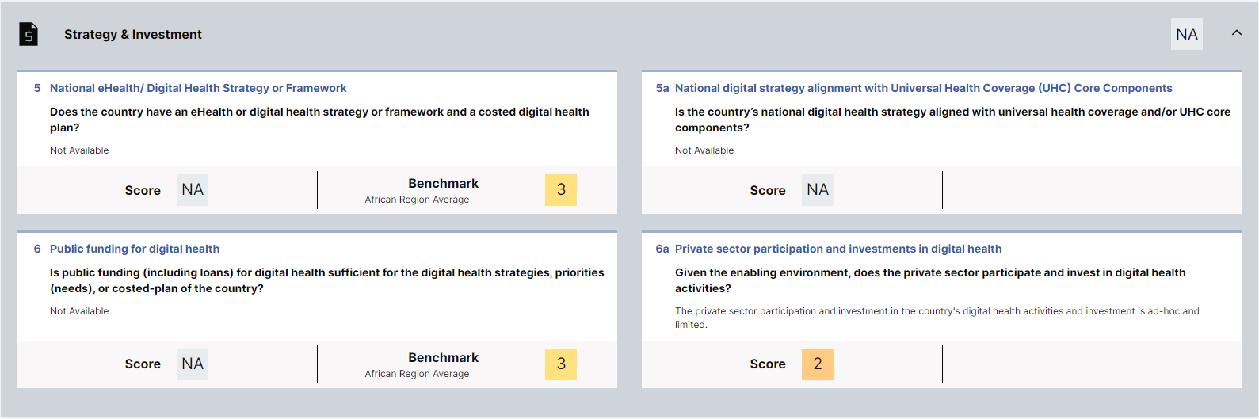
STRATEGY & INVESTMENT
The private sector participation and investment in the country's digital health activities and investment is ad-hoc and limited.
https://monitor.digitalhealthmonitor.org/country_profile/BWA 2023 data

Slide 11
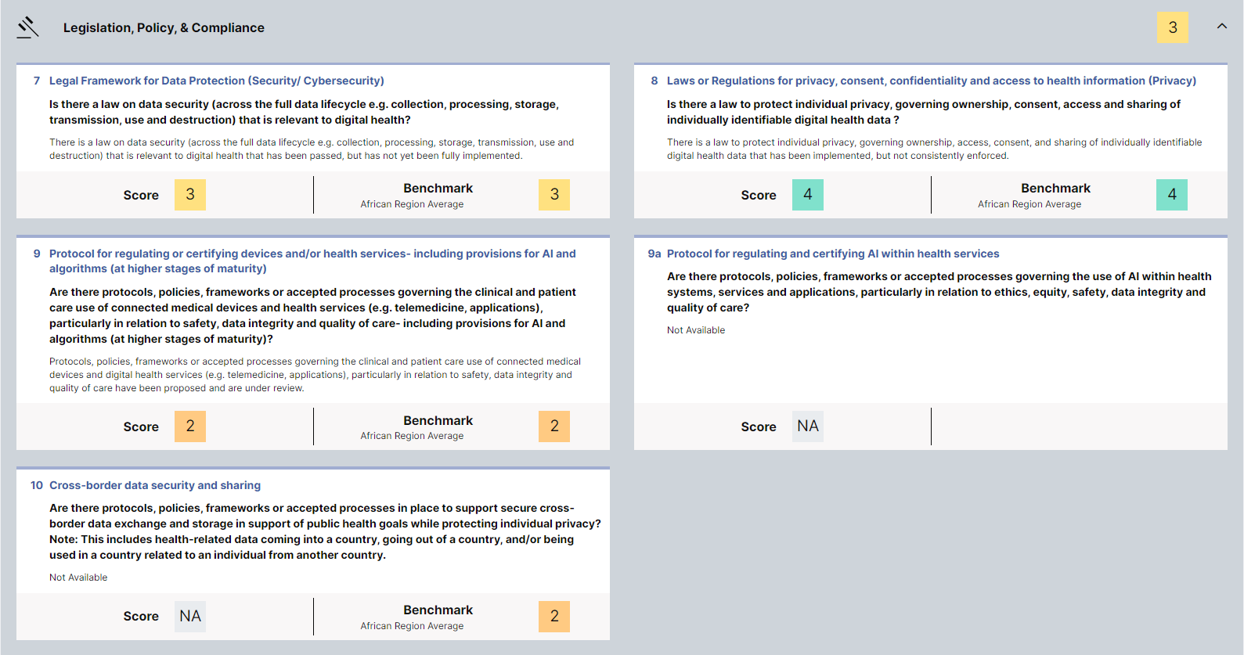
LEGISLATION, POLICY, & COMPLIANCE
There is a law on data security (across the full data lifecycle e.g. collection, processing, storage, transmission, use and destruction) that is relevant to digital health that has been passed, but has not yet been fully implemented.
There is a law to protect individual privacy, governing ownership, access, consent, and sharing of individually identifiable digital health data that has been implemented, but not consistently enforced.
Protocols, policies, frameworks or accepted processes governing the clinical and patient care use of connected medical devices and digital health services (e.g. telemedicine, applications), particularly in relation to safety, data integrity and quality of care have been proposed and are under review.
https://monitor.digitalhealthmonitor.org/country_profile/BWA 2023 data

Slide 12
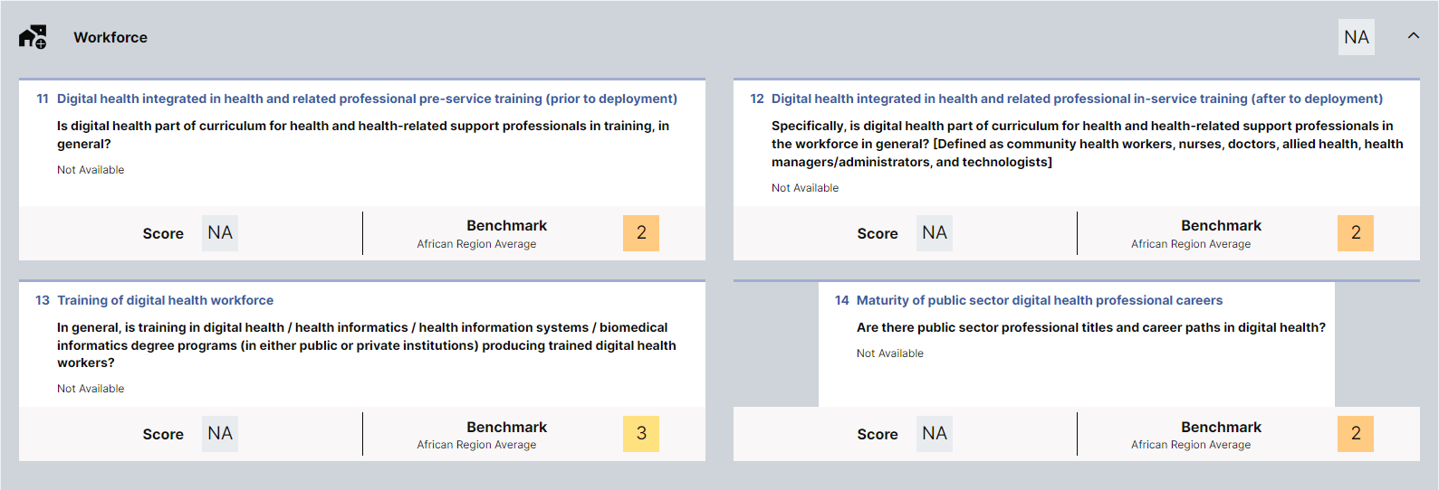
WORKFORCE
https://monitor.digitalhealthmonitor.org/country_profile/BWA 2023 data

Slide 13
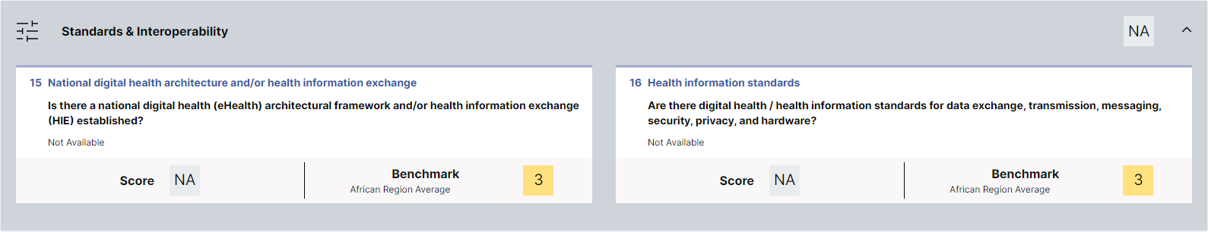
STANDARDS & INTEROPERABILITY
https://monitor.digitalhealthmonitor.org/country_profile/BWA 2023 data

Slide 14
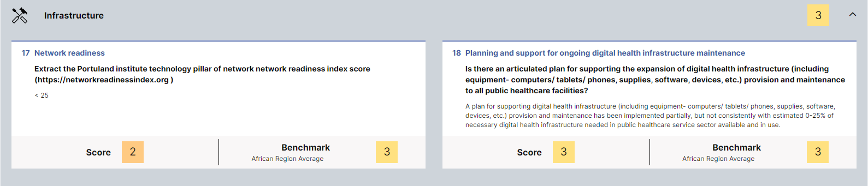
INFRASTRUCTURE
A plan for supporting digital health infrastructure (including equipment computers/tablets/ phones, supplies, software, devices, etc.) provision and maintenance has been implemented partially, but not consistently with estimated 0-25% of necessary digital health infrastructure needed in public healthcare service sector available and in use.
https://monitor.digitalhealthmonitor.org/country_profile/BWA 2023 data

Slide 15
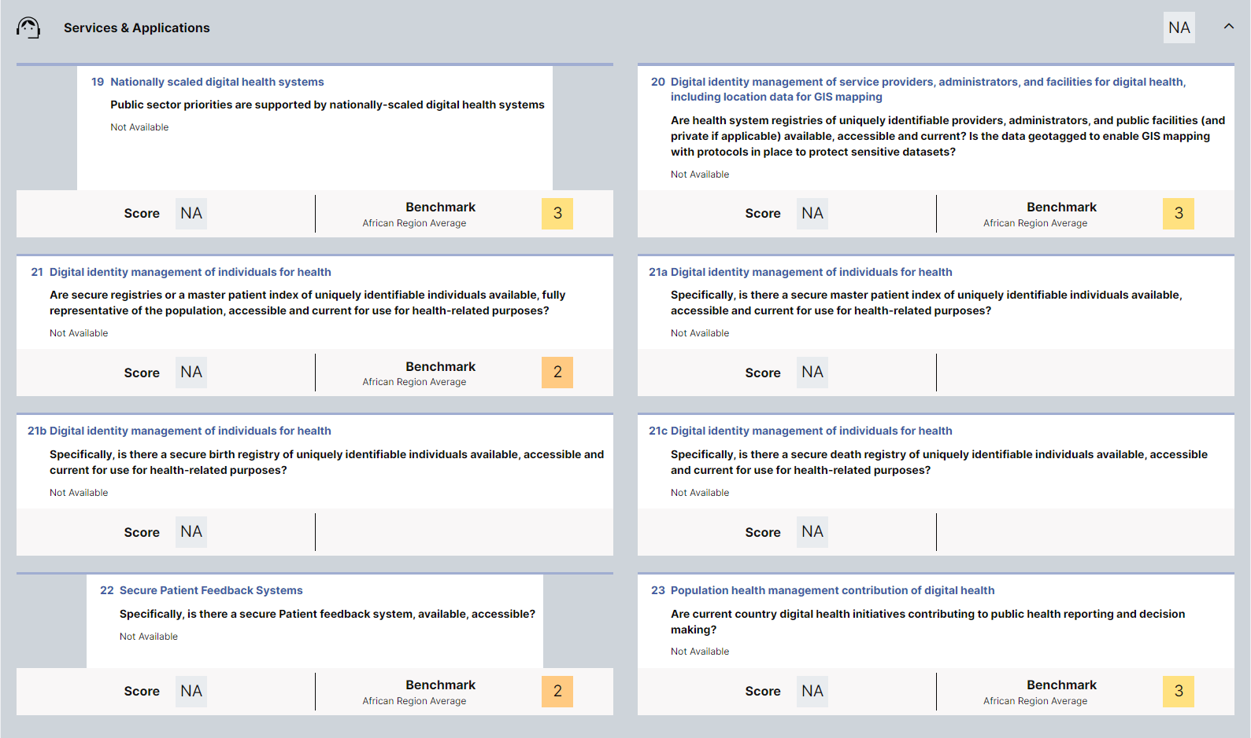
SERVICES & APPLICATIONS
https://monitor.digitalhealthmonitor.org/country_profile/BWA 2023 data

Slide 16
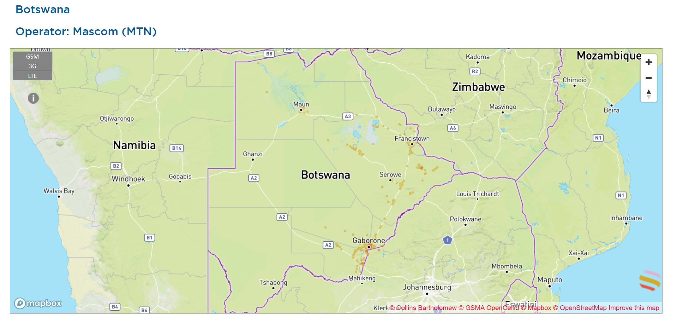
MOBILE NETWORK COVERAGE

Slide 17
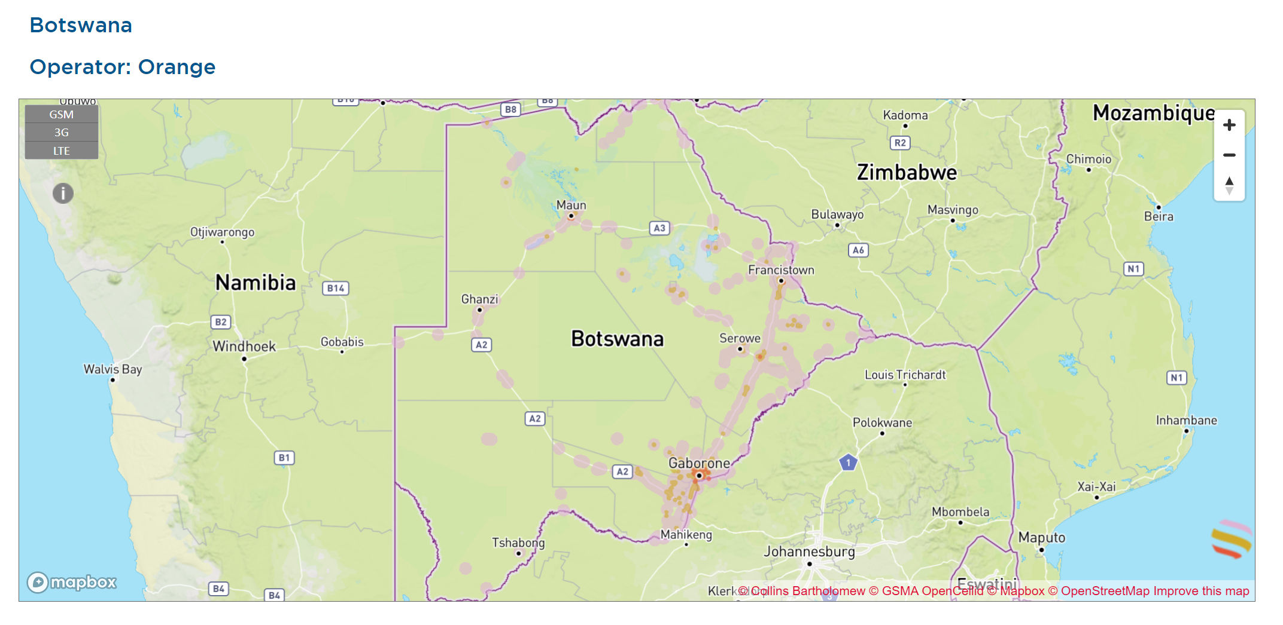
MOBILE NETWORK COVERAGE

Slide 18
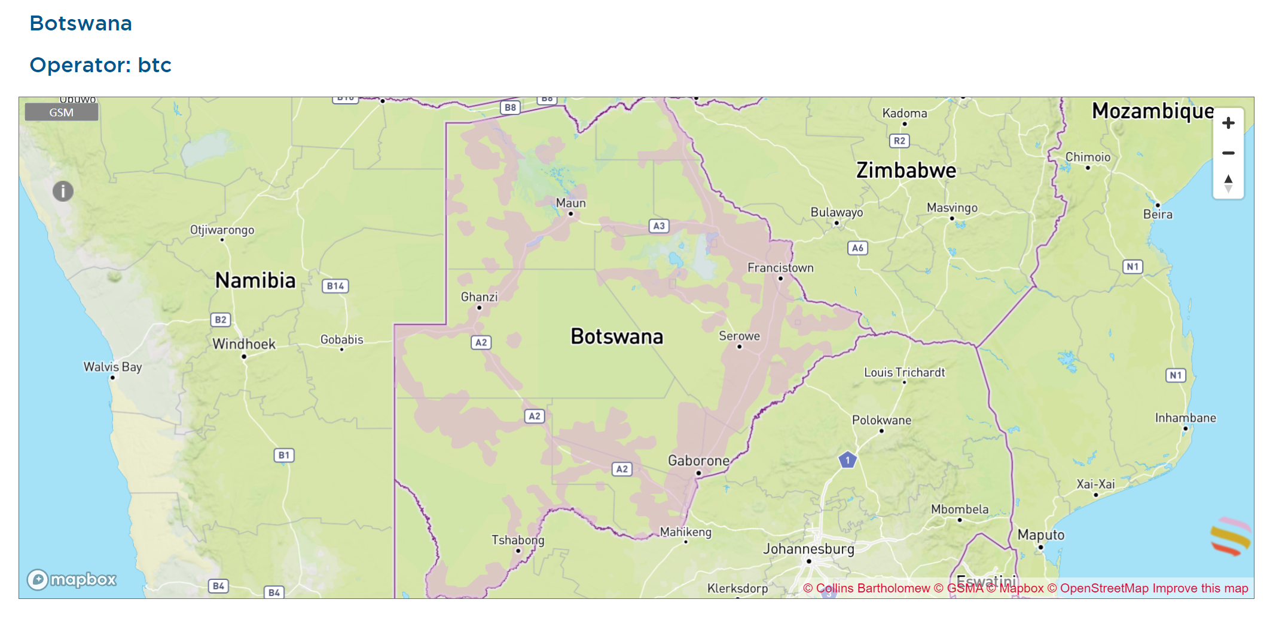
MOBILE NETWORK COVERAGE

Slide 19

KEY TAKEAWAY POINTS
Botswana’s readiness is generally consistent with its African peers. We have a Digital Health Phase score of 3 out of 5.
There are notable gaps in four key areas:
Strategy & Investment
Workforce
Standards & Interoperability
Services & Applications
The challenges are genuine. To succeed, any plan for national-scale implementation would need to address these gaps.

Slide 20

Questions and Answers?

Slide 21
INTERACTION 1.1
<paste Form link here>
What do you believe are the top 2 challenges impeding digital health adoption? [electricity; network access; hardware availability; software availability and capability; digital literacy; data entry burden; health impact; data privacy; governance; political will; implementation project funding; health worker compensation; other]
What do you believe are the top 2 accelerators for digital health adoption? [electricity; network access; hardware availability; software availability; digital literacy; data entry burden; health impact; data privacy; governance; political will; implementation project funding; health worker compensation; other]

Slide 22

What are our health metrics; what is our current burden of disease?

Slide 23
IHME COUNTY METRICS
<capture graphics from the IHME website’s country overview – prepare slides with one graphic per slide with a note regarding relevance>
NOTE: Botswana example

Slide 24
Based on IHME, what are our what are our health metrics, including our current burden of disease?
https://www.healthdata.org/research-analysis/health-by-location/profiles/botswana

Slide 25
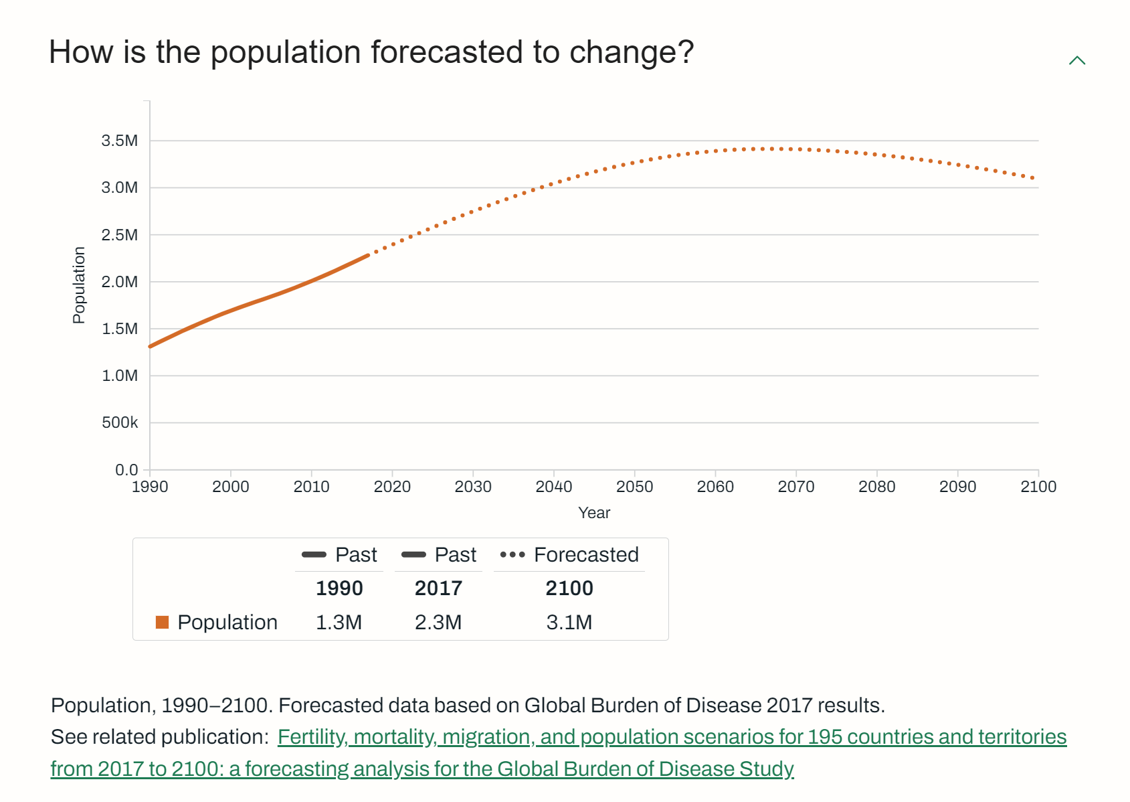
50% increase over coming 25 years.

Slide 26
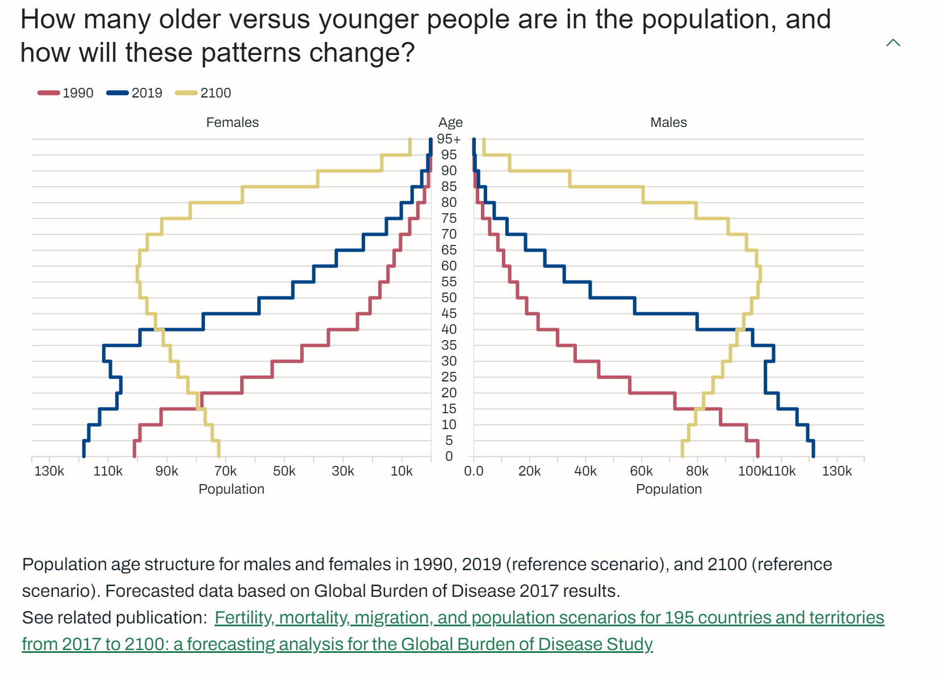
The “pyramid” becomes a water tower.

Slide 27
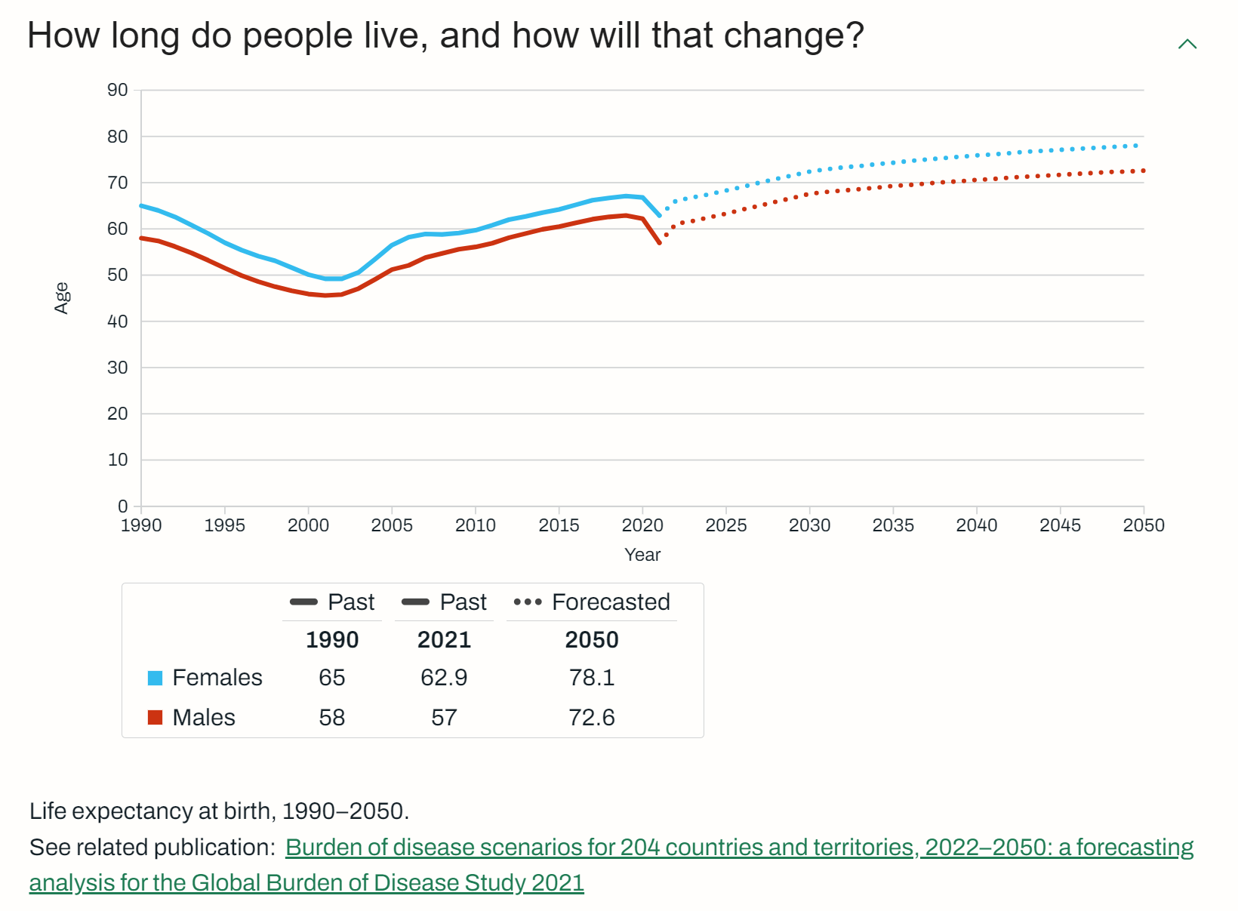
The “grey tsunami” will increase the NCD burden.

Slide 28
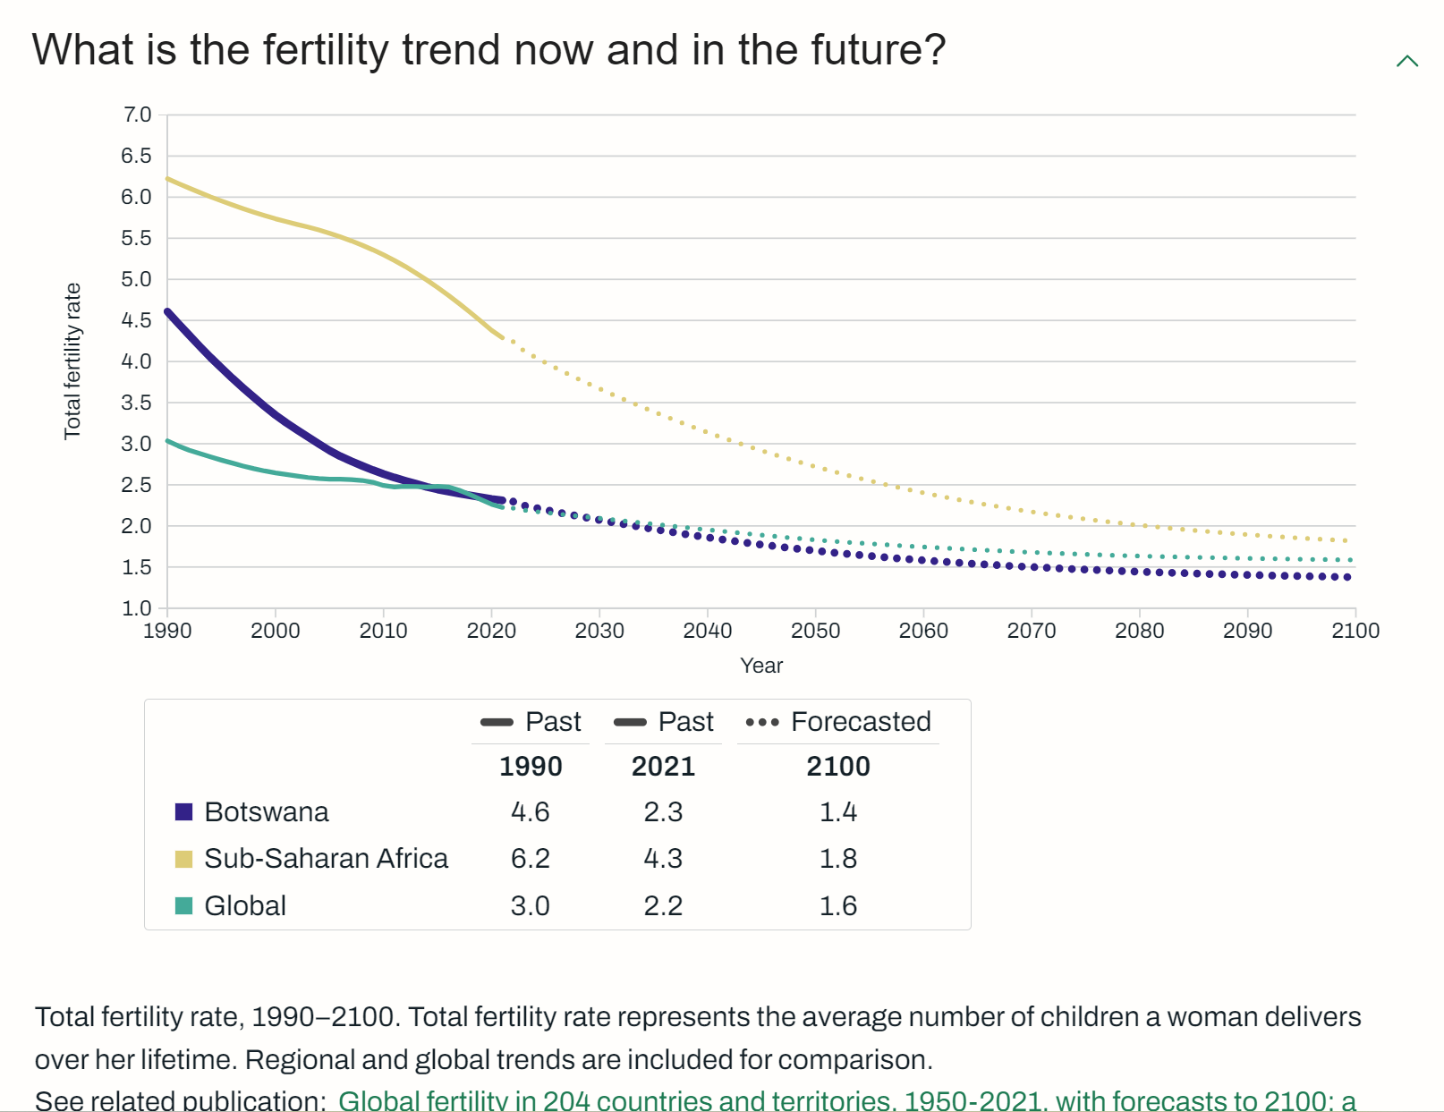
Our trend is “ahead” of the SSA curve.

Slide 29
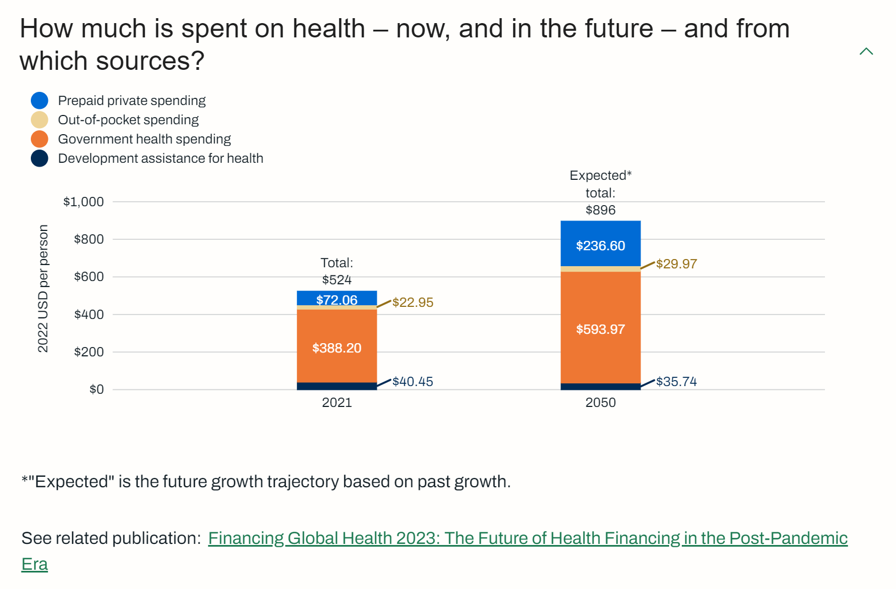
The proportion of private insurance will increase.

Slide 30
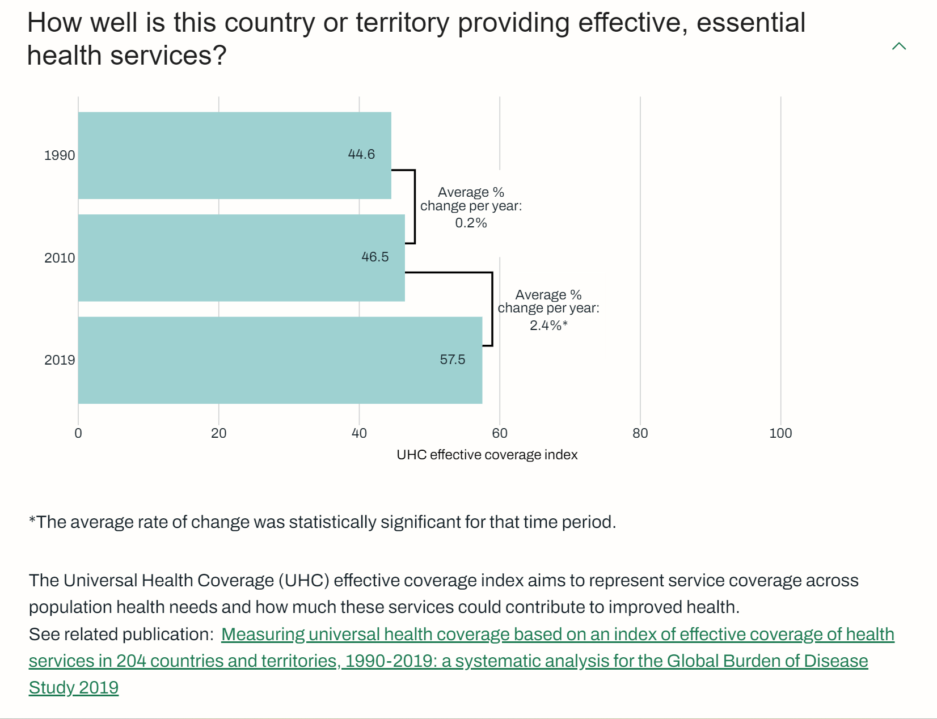
There is steady progress… and room to improve.

Slide 31
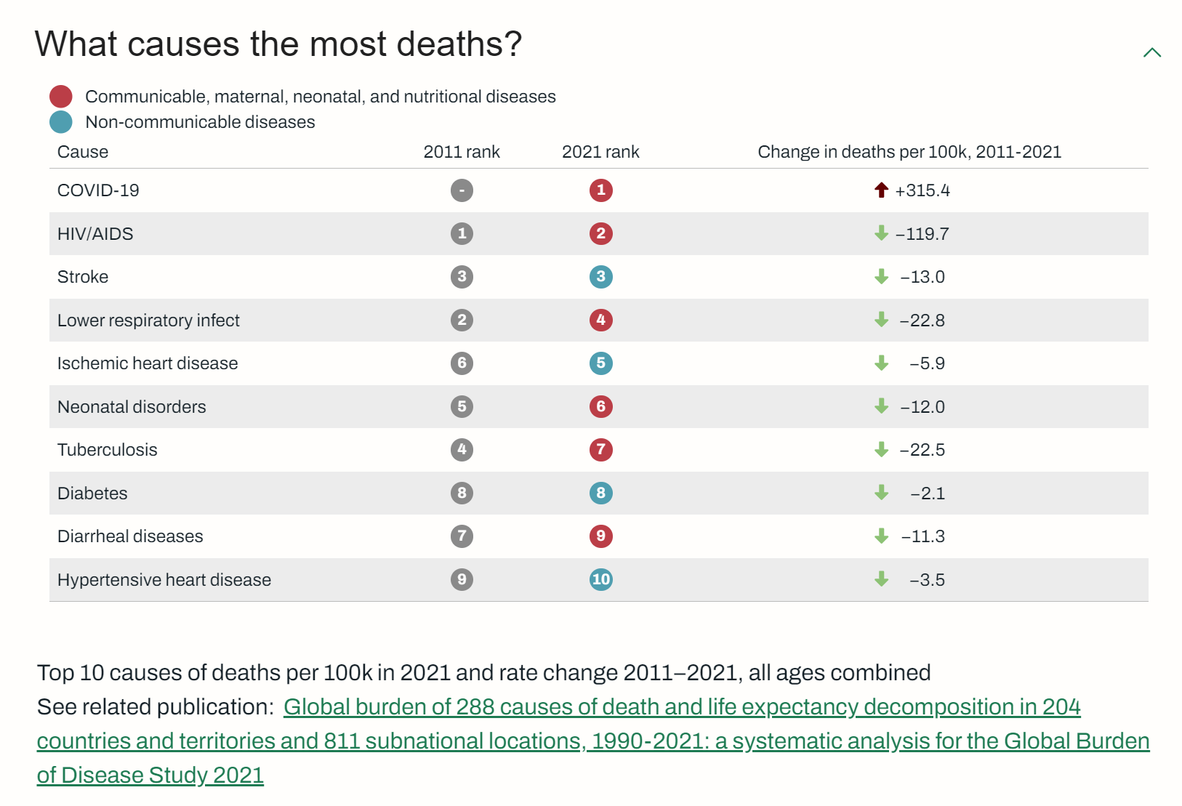
4 of 10 NCDs

Slide 32
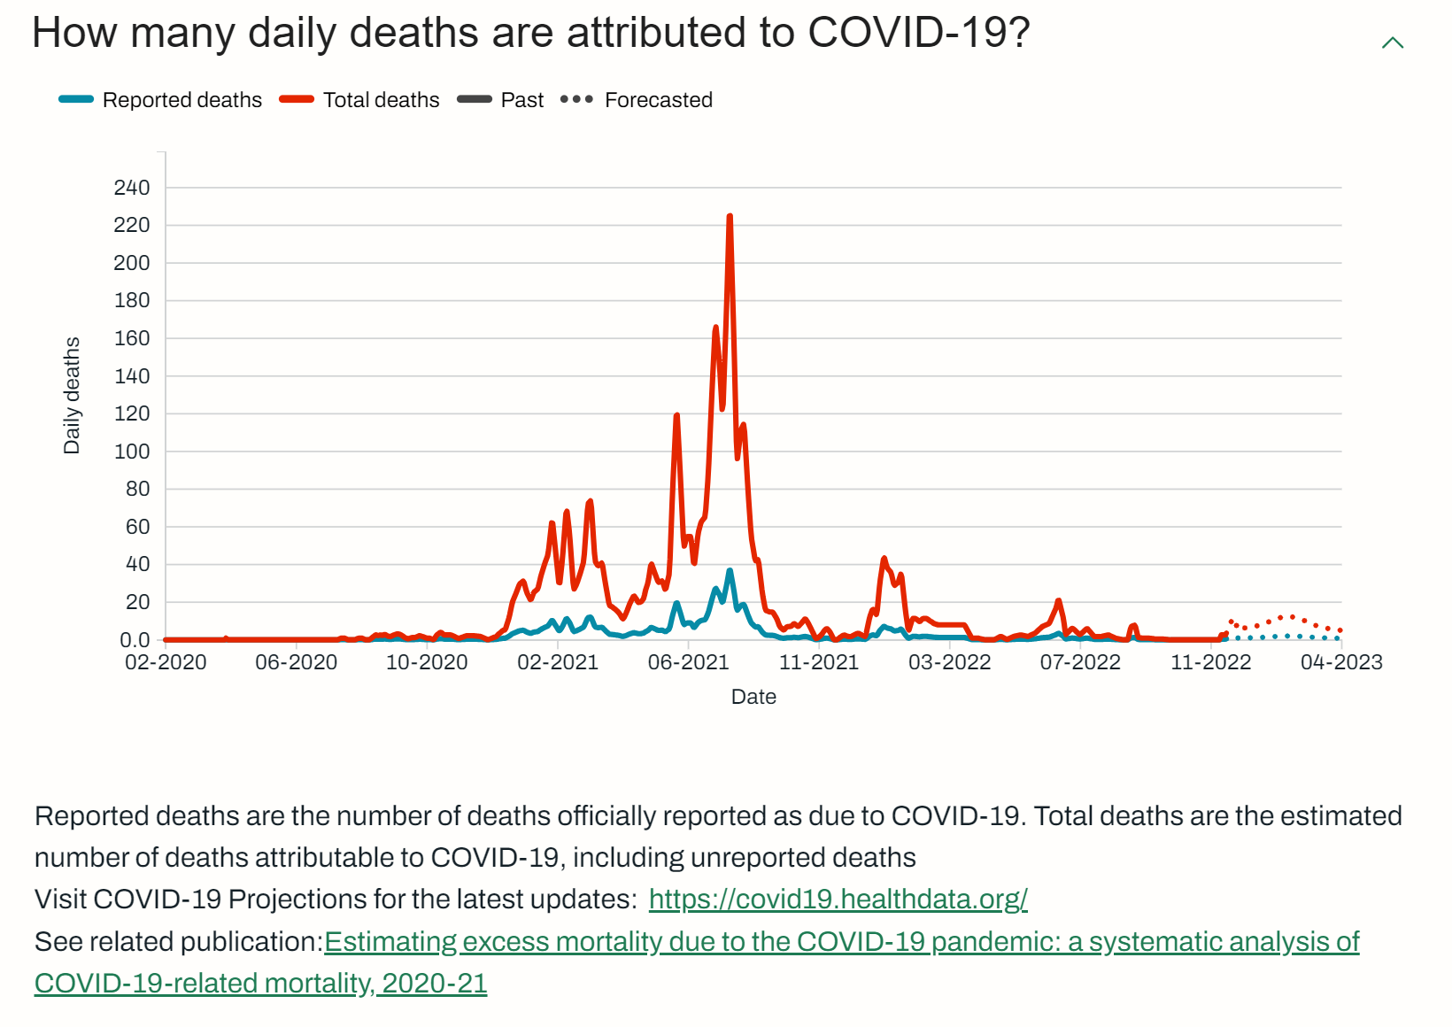
The actual rates outpaced the reported rates.

Slide 33
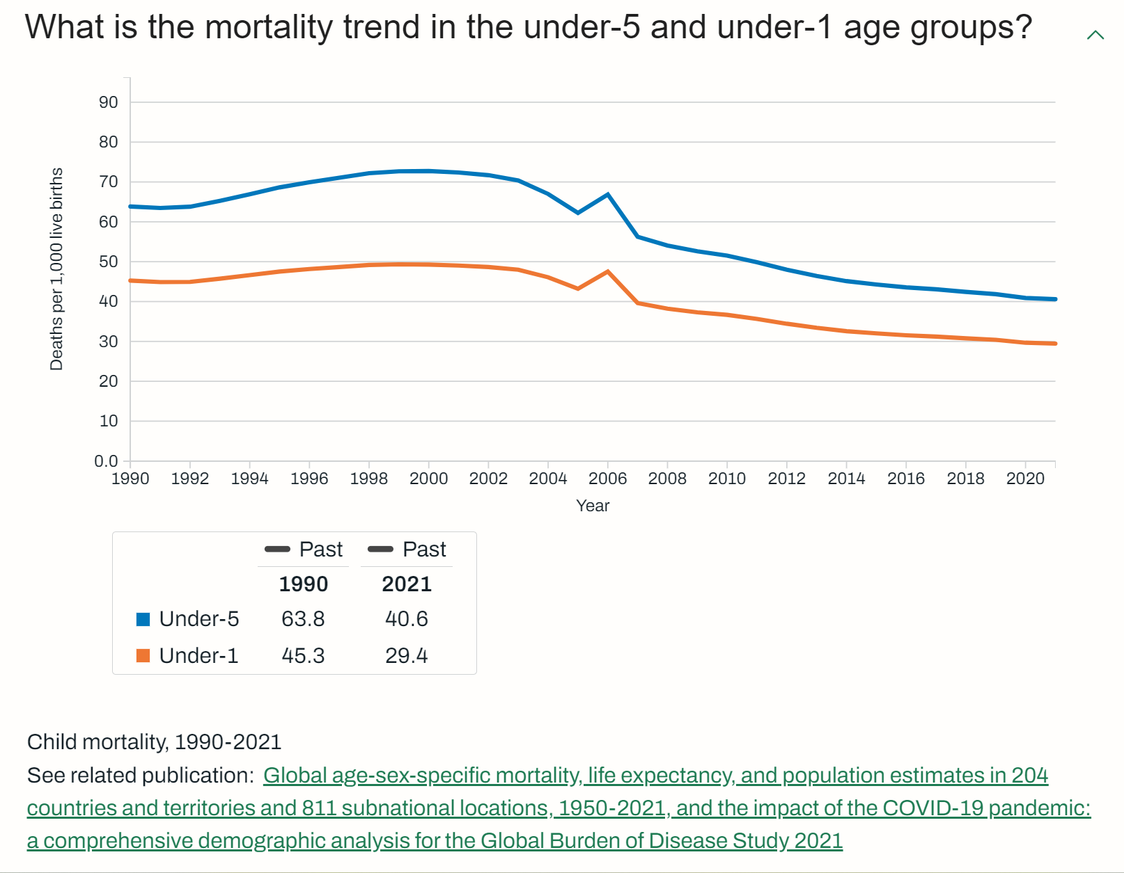
Steady, long-term progress, with room to improve.

Slide 34
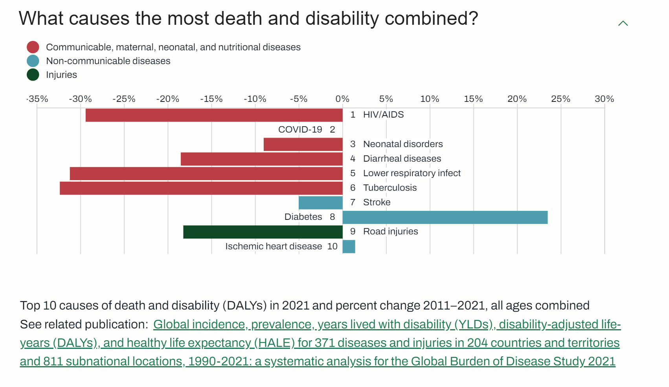
Great progress on reducing the overall burden.

Slide 35
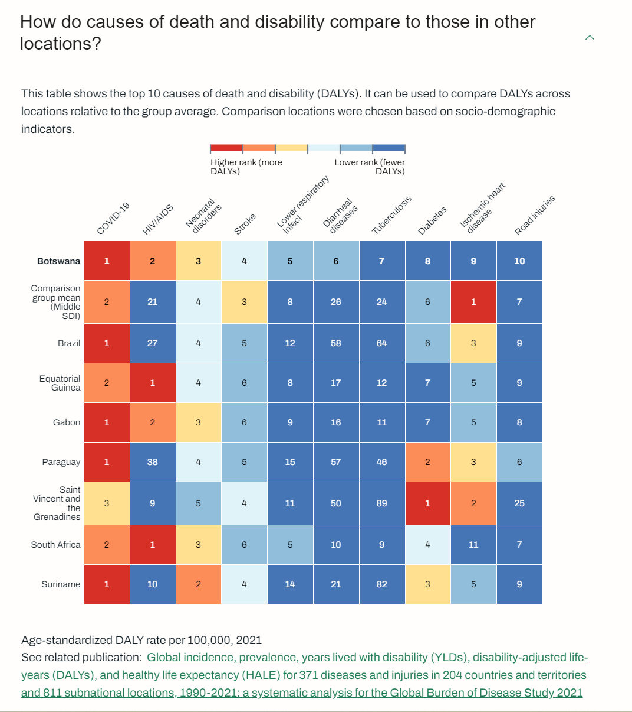
On NCDs we do well vs. peers. COVID hit us hard.

Slide 36
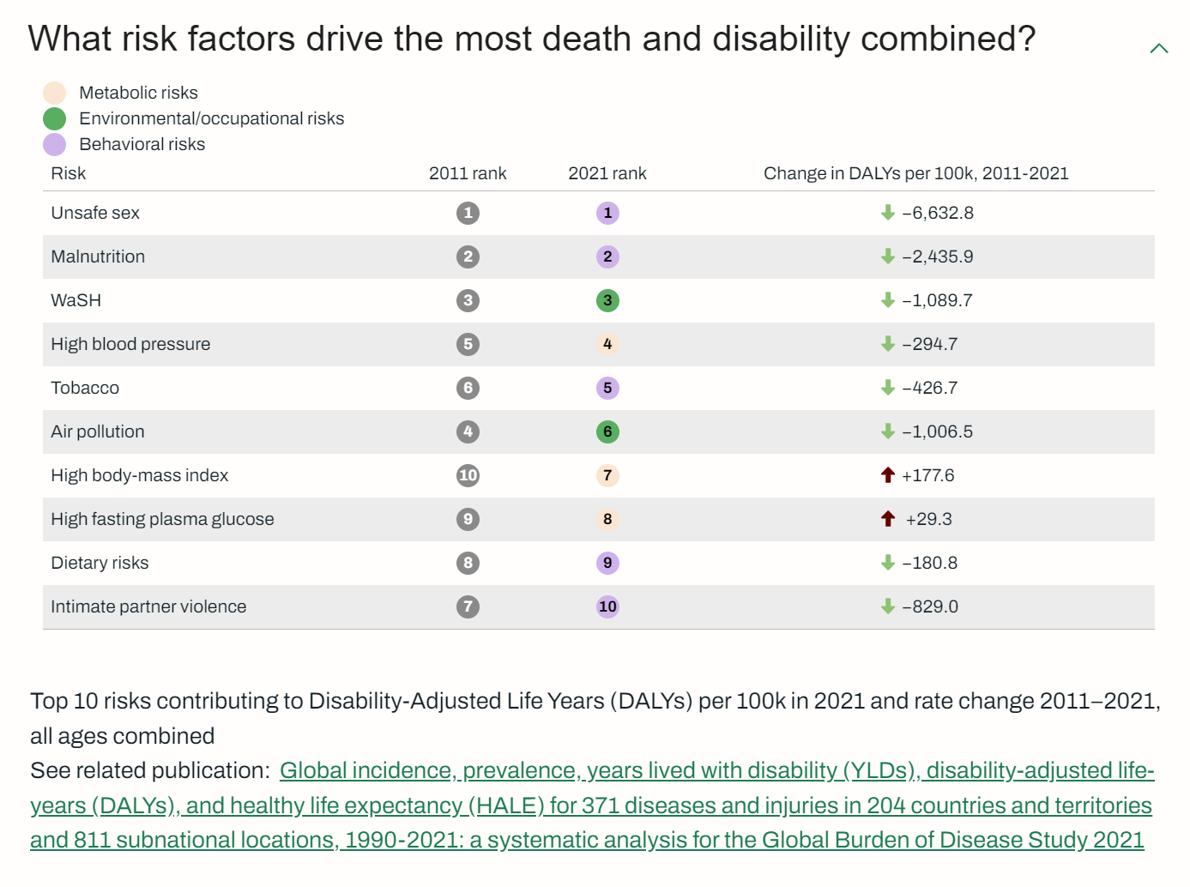
*
*
*
*
Many risks addressable through health interventions.
*

Slide 37
KEY TAKEAWAY POINTS
Botswana’s burden of disease is still dominated by communicable and neonatal diseases; these represent six of the top ten.
Significant progress has been made in addressing the overall burden. Excepting COVID, there are reductions across the “top-7”, with three reduced by ~30% between 2011-2021.
NCDs are a concern. Diabetes’ burden has increased 23% over the last decade.

Slide 38

Questions and Answers?

Slide 39
INTERACTION 1.2
<paste Form link here>
Were you surprised at the top 10 DALYs? [yes, no]
What do you believe should be the top 2 care use cases supported by our national HIE? [prepare choice list of top 10 DALYs; other]
In what 2 areas do you believe we should focus regarding health system reportable indicators. [service availability; resource availability; care access/equity; service usage; care quality; health outcomes; costs; cost effectiveness; other]

Slide 40

COFFEE BREAK!
Notes:
Use this slide as a “break slide”

Slide 41

What are our current health and digital health strategies?

Slide 42
THIS SECTION…
Highlight and summarize key elements of the national health strategy. Particularly note the sections on health information.
Summarize key elements of the national digital health strategy. Particularly note sections on M&E vs care delivery.
Compare and contrast these strategies:
When were they published? (are they out of date?)
Are they consistent with each other?
Are they both consistent with the burden of disease and do they address it?
NOTE: Example from Botswana

Slide 43


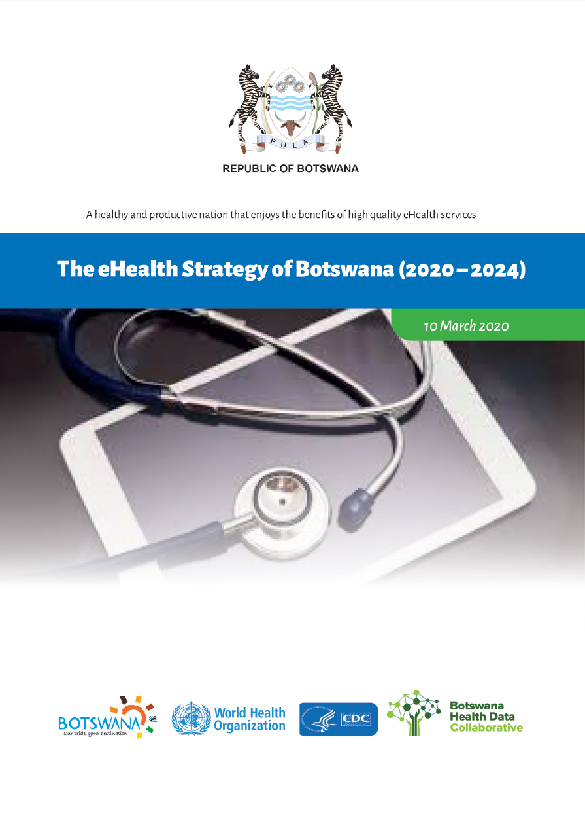
November 2010
January 2018
March 2020

Slide 44
“Health service delivery in the country is pluralistic. There are public, private for-profit, private non-profit, and traditional medicine practices. The Ministry of Health (MOH) is responsible for the formulation of policies, regulation and norms, and standards and guidelines for health services. Government has achieved the Abuja target of contributing 15% of total government expenditure to health (representing around 75% of total health expenditure). With the relocation of primary health care from the Ministry of Local Government (MLG), the MOH is now the principal public sector health care provider.”
“Health management information is weak. Challenges include untimely data collection, collation, analysis, interpretation, and dissemination of information. The situation in compounded by the existence of several databases (epidemiology, human resources, finance etc) existing in parallel. Monitoring and evaluation is fragmented; as a consequence, tracking health outcomes, and measuring the impact of specific interventions is compromised.”
November 2010

Slide 45
Objectives of the IHSP
“The goal of service delivery is the attainment of universal coverage of a high-quality package of essential health services, EHSP, through:
Scale up of utilisation of a well defined and comprehensive essential health service package;
Redefining existing service delivery levels and delineating types of health services for each of these levels of the health care to ensure continuity and harmonised referral and supervisory functions;
Increasing and strengthening partnerships with the private sector and NGOs
Community involvement to ensure effective demand for health services
Promoting community participation in the planning and delivery of health services.”
November 2010

Slide 46
Objectives of the IHSP
“The Health Information and Research goal is to create an enabling environment for efficient monitoring and evaluation of the implementation and achievements of the integrated health service plan and to provide the basis for evidence-based decision-making. The objectives are:
To collect and analyse health information about diseases, services, finances, health workforce, medicines and medical products, infrastructure and equipment from all stakeholders of the health sector.
To clarify the roles and functions of different stakeholders in data management in order to minimise duplication and maximise optimal utilization of resources
To ensure timely, wide, and need-based dissemination of data to all stakeholders.
To develop and implement a research agenda in collaboration with relevant partners to support national policy development
To develop and implement regulations regarding mandatory reporting of defined information requirements
To develop, implement and enforce regulatory mechanism for health research.”
November 2010

Slide 47
“This national strategy will focus on the four major NCDs, which account for 82% of NCD-related deaths (cancers, cardiovascular diseases, diabetes, chronic respiratory disease), as well as the four common modifiable risk factors they are associated with (smoking, harmful use of alcohol, unhealthy diet, and physical inactivity). Broader definitions of NCDs are recognised, including injuries and mental illness, as well as those conditions referred to in the Brazzaville Declaration (hemoglobinopathies, oral disease, eye disease, rheumatic heart disease). While these conditions are important, the approach taken in this strategy was to maintain a narrow focus in order to address the areas of highest burden and areas with the greatest gaps, and facilitate effective implementation of their ‘best buys’ interventions.”
Top-4 NCD causes of death from IHME (2021):
#3 Stroke
#5 Ischemic Heart Disease
#8 Diabetes
#10 Hypertensive Heart Disease
January 2018

Slide 48
“…[M]any individuals who have an NCD are undiagnosed and unaware of it. The STEPS 2014 survey revealed that 23% of those with hypertension were not aware and not on treatment. Furthermore, 70% of cancers reported nationally with staging information available are diagnosed at advanced stage. This limits the impact of treatment and the chances of long-term survival.”
January 2018

Slide 49
“The rising burden of NCDs in the country is of great concern to the Government of Botswana and is a threat to the achievement of the Sustainable Development Goals 2016-2030 and Vision 2036. The prevention and control of NCDs has been prioritised and included in high-level national strategy documents such as the 11th National Development Plan (2017-2023), Ministry of Health and Wellness strategy 2017-2023 and the National Essential Health Services package.
NCD diagnosis and management has also been incorporated into the National Strategic Framework III for HIV/AIDS. Finally, a national harmonisation of community-based interventions in health is underway, which will include standardised basic NCD prevention and control services offered by community health workers.”
January 2018

Slide 50
March 2020

Slide 51
March 2020

Slide 52
KEY TAKEAWAY POINTS
Botswana’s strategic health focus is broadening (since 2010) to address the growing NCD burden.
Driven by UHC goals, a package of basic health services has been defined, largely to be delivered in primary or community care settings.
More recently, the digital health focus has shifted from M&E-only toward broader support of care delivery workflows executed at the point of service.
Care continuity is recognized as important. Health data sharing infrastructure has been identified as a strategic initiative to help address it.
Botswana needs a national digital health “blueprint”, including national norms and standards.

Slide 53
HEALTH STRATEGY

Slide 54
DIGITAL HEALTH STRATEGY

Slide 55
STRATEGIC ALIGNMENT…

Slide 56

Questions and Answers?

Slide 57
INTERACTION 1.3
<paste Form link here>
How often do you believe our health strategy should be updated?
How often do you believe our digital health strategy should be updated?
How often do you believe our digital health blueprint should be updated?
Is our health strategy well aligned to addressing our national burden of disease?
Is our digital health strategy well aligned to our health strategy?
Is our digital health strategy well aligned to addressing our national burden of disease?
Would a national HIE well support our strategic goals?
Would a national HIE well address our disease burden?

Slide 58

How can digital health be leveraged to improve health?

Slide 59
Theory of change:
“We want to maximize the care delivered in the GREEN ZONE.”
Errors of
Omission
Everything that was done
The GREEN ZONE
Everything that should be done
Errors of Commission

Slide 60
HOW CAN DIGITAL HEALTH IMPROVE CARE?
For many diseases / conditions, normative bodies publish best-practice care guidelines.
Leveraging the HL7 FHIR® standard, these normative care guidelines can be expressed as conformance-testable Computable Care Guidelines (CCGs).
Reflecting on Interaction 1.2 – what guideline-based care workflows should we consider?

Slide 61


Level 1: Narrative
Level 2: Semi-structured
Level 3: Computable
Level 4: Operationalized
Notes:
The CCG life cycle goes through 4 levels of knowledge representation.

Slide 62
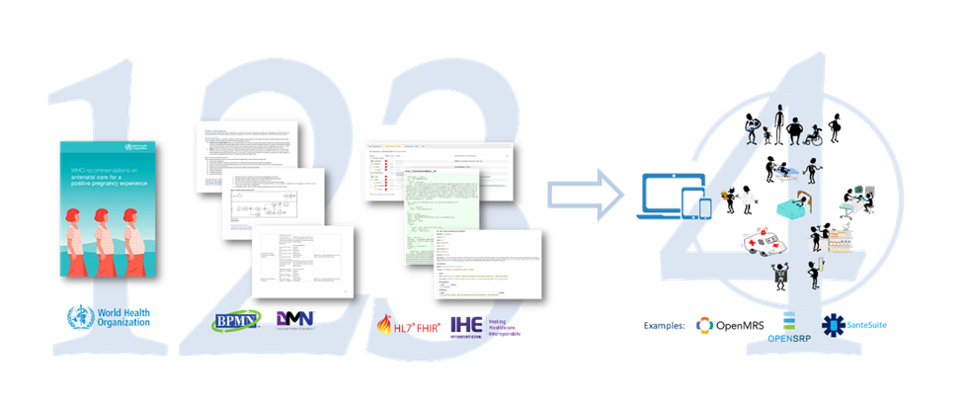
At Level 1 (or L1) are the narrative guidelines published by WHO or by normative national bodies such as the CDC or Diabetes Canada (as examples).
Notes:
At Level 1 (or L1) are the narrative guidelines published by WHO or by normative national bodies such as the CDC or Diabetes Canada (as examples).

Slide 63
Level 2 (L2) artefacts distill the narrative text into a set of personas, user stories, workflow diagrams (such as BPMN diagrams) and decision tables. WHO calls their L2 artefacts: Digital Adaptation Kits (DAKs).
Notes:
Level 2 artefacts distill the narrative text into a set of personas, user stories, workflow diagrams (such as BPMN diagrams) and decision tables. WHO calls their L2 artefacts: Digital Adaptation Kits.

Slide 64
At Level 3 (L3) are the CCGs themselves. These are FHIR packages that contain the collection of FHIR resources and libraries that define a machine-interpretable version of the care guideline.
Notes:
At Level 3 are the CCGs themselves. These are FHIR packages that contain the collection of FHIR resources and libraries that define a machine-interpretable version of the care guideline.

Slide 65
Finally, at Level 4 (L4), the L3 artefacts are ingested by and operationalized by digital health solutions across the entire care delivery network.
Notes:
Finally, at Level 4, the L3 artefacts are ingested by and operationalized by a digital health solution.

Slide 66

CCGs operationalize care quality, at scale.

Slide 67
CCG-SUPPORTED CARE “ACTIVITIES”
Provide counselling
Record observations
Order tests
Record test results
Establish diagnosis
Order procedures
Provide procedures
Order medications
Dispense medications
Administer medications
Establish monitoring and follow-up (schedule next visit)
Refer (escalate care)

Slide 68

Questions and Answers?

Slide 69
INTERACTION 1.4
<paste Form link here>
What functional activities are part of your 2 care use case workflows? Check all that apply. [list of health story activities; other]
What proportion of the care delivery network is, today, “digitally ready” for your 2 care use cases? [<20%, 20-40%, 40-60%, 60-80%, 80-100%]
How many years would it take us to be digitally ready across most (+80%) of our care network? [1,2,3,4,5, more than 5 years]

Slide 70
NEXT STEPS…WORKSHOP 2
Leverage existing digital health frameworks and standards to define the functional footprint of a national HIE infrastructure.
Explore HIE deployment models.
Establish the point of service (POS) solution requirements needed to support broad scaling of guideline-based care that addresses our national burden of disease.
REMEMBER
You will need your PC, tablet, or smartphone
to fill in the questionnaires.

